Slide 1

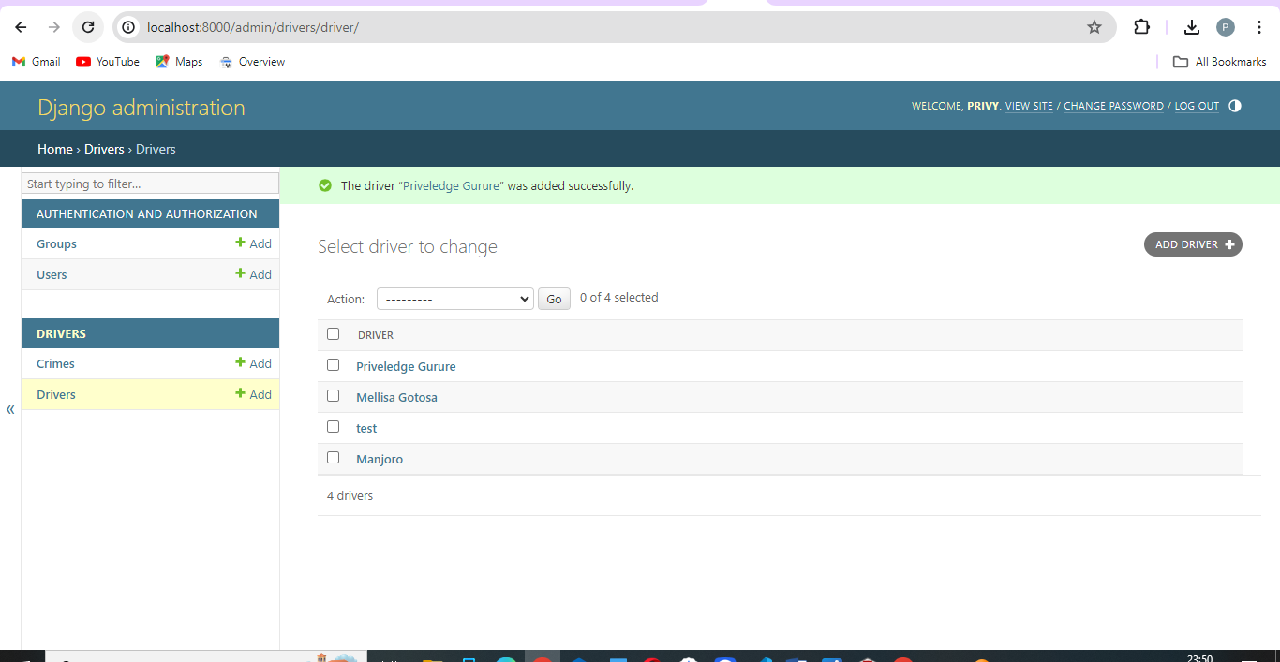
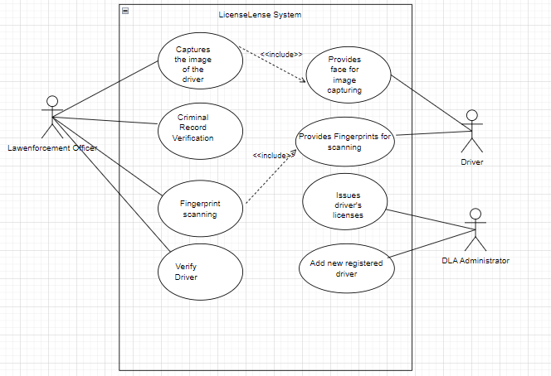
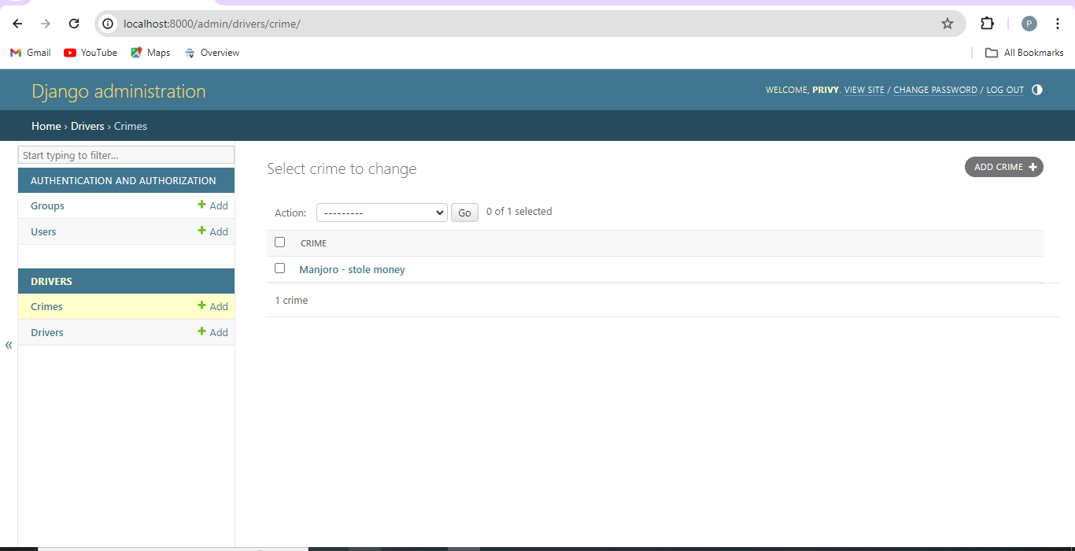
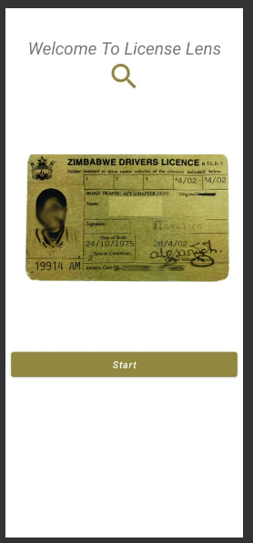
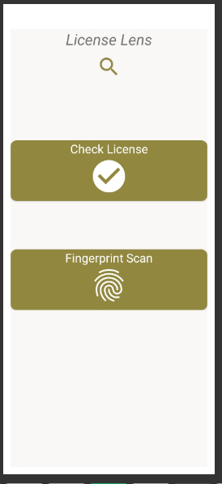



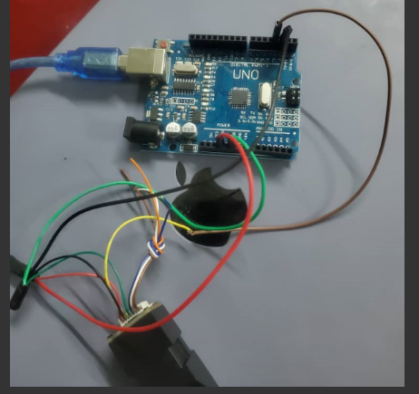
LICENSELENSE SYSTEM
Priveledge Gurure- Software Engineering Department
1.0 Abstract
3.0. Problem definition
7.0. Use Case Diagram
In Zimbabwe, the lack of an efficient driver identification and verification system has led to a significant increase in road accidents, fraudulent activities, and criminal cases involving unlicensed drivers. To address this critical issue, I propose a novel multi-modal biometric system, LicenseLense, which combines facial recognition and fingerprint scanning technologies to ensure accurate and efficient driver identification. LicenseLense solves the problem of unlicensed driving, identity fraud, and criminal activity by providing a robust and secure system for verifying driver identity and criminal record status in real-time. The system integrates with government databases and law enforcement systems, enabling authorities to make informed decisions and take prompt action against offenders. This system offers a solution to the long-standing problem of driver identification in Zimbabwe, enhancing road safety, reducing fraudulent activities, and supporting law enforcement efforts
The current method for assessing licensed drivers in Zimbabwe, which is mostly based on physical licenses and visual verification by authorities, poses various issues that might have a severe influence on road safety. People who own vehicles require a license to drive them. Sometimes drivers forget to bring their license with them and are confronted by law enforcement agents for their defiance. The current manual process of checking driver's licenses in Zimbabwe is difficult to manage, especially in high traffic areas. This can lead to increased wait times and delays for drivers, as well as potential safety issues if unlicensed drivers are allowed to operate vehicles.
2.0. Introduction
4.0. Overview of the developed application
LicenseLense is a mobile application system that verifies the identity and criminal record status of licensed drivers in real-time. Using facial recognition and fingerprint scanning technologies, the system ensures that only authorized drivers are on the roads, reducing fraud and enhancing road safety. The system integrates with government databases and provides instant verification results, making it an efficient solution for law enforcement agencies and transportation authorities.
8.0. Screenshots
Driver's licenses are an essential form of identity and proof of driving for billions of individuals worldwide. However, the process of inspecting and confirming driver's licenses can be time-consuming and inefficient, making it difficult to assure that licenses are genuine and legitimate. This is especially true in poor nations, where many driver's licenses are manually issued and no central database exists to preserve and validate license information. In recent years, the importance of road safety and the need to prevent illegal activities on our roads have become increasingly evident. One crucial aspect of ensuring road safety is verifying the identity of licensed drivers. Traditional methods of driver identification, such as manual checks of physical licenses, have limitations and vulnerabilities. To address these challenges, this documentation presents a facial recognition system designed to identify licensed drivers, verify their identity and criminal record status, and implement fingerprint scanning as a secondary authentication method.
As a result, people frequently drive with expired or invalid licenses, or use counterfeit licenses. This can cause a number of issues, including an increased risk of road accidents. Drivers with expired or invalid licenses are more likely to be involved in accidents because they may be unfamiliar with current traffic laws or lack the essential skills and expertise to drive safely.
The process of checking driver's licenses in Zimbabwe is currently manual and time consuming. It requires personally viewing the driver's license and manually validating the information. This technique is error-prone and difficult to regulate, especially in high-traffic areas. To address this issue, I propose a facial recognition system for checking licensed drivers and also uses fingerprint scanning as a secondary authentication method for driver identification systems where facial recognition may be compromised due to facial deformation. The device will scan the driver's face to verify their identity and license information.
5.0. Objectives
To develop a facial recognition system for identifying licensed drivers.
To verify driver identity and criminal record status.
To implement fingerprint scanning as a secondary authentication method for driver identification systems where facial recognition may be compromised due to facial deformation.
Conclusion
In conclusion, LicenseLense is a revolutionary mobile application system that harnesses the power of facial recognition and fingerprint scanning technologies to verify the identity and criminal record status of licensed drivers in real-time. By providing a secure, efficient, and user-friendly solution, LicenseLense enhances road safety, reduces fraud, and improves efficiency for law enforcement agencies and transportation authorities. With its robust features and benefits, LicenseLense is poised to transform the way we approach driver verification, making our roads safer and more secure for all in our country
6.0. System Overview
Supervisor –W. Makondo

